Slide 1
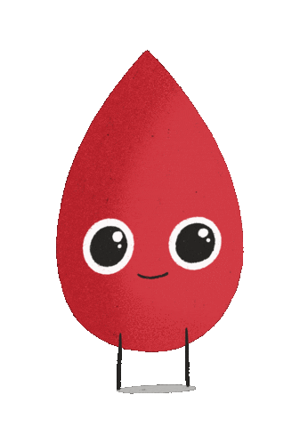

Ready for our quiz???
Notes:
This quiz is intended for children and needs to be guided by informal educators. There are many possibilities where the important concepts of biobanking can be included in some explanation around an answer to a question. There are quiz questions about the human body and opinion questions.

Slide 2
What is stored in a BIOBANK?
human tissue (like blood, urine and hair) and medical data
biological fruit and vegetables
money out of eco-friendly paper

Slide 3
What is stored in a BIOBANK?
human tissue (like blood, urine and hair) and medical data
biological fruit and vegetables
money out of eco-friendly paper

Slide 4
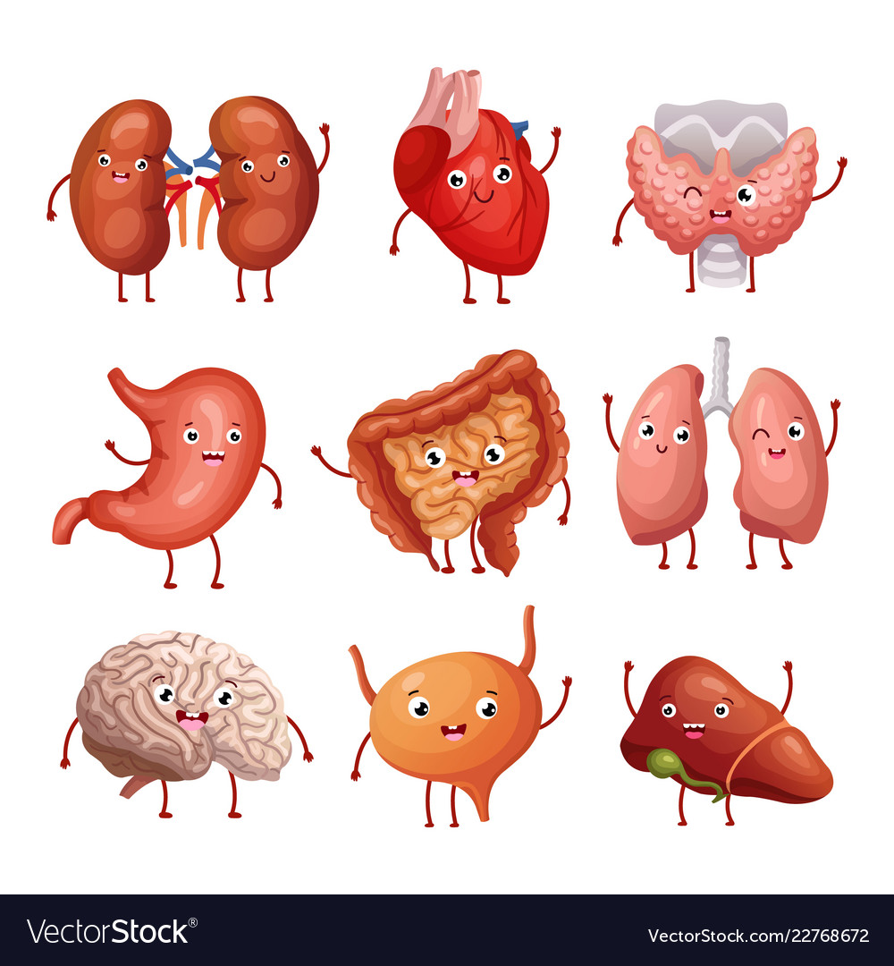
How many liters of blood has a human?
10 liters
(big water bucket)
250 milliliters
(glass of water)
3 – 6 liters
(3 – 6 milk cartons)

Slide 5
How many liters of blood has a human?
10 liters
(big water bucket)
250 milliliters
(glass of water)
3 – 6 liters
(3 – 6 milk cartons)

Slide 6

How heavy is your brain?
Just over
1 kilogram
(bit more than a milk carton)
200 grams
(like 2 chocolate bars)
3 kilograms
(like a medicine ball in
sports class)

Slide 7
How heavy is your brain?
Just over
1 kilogram
(bit more than a milk carton)
200 grams
(like 2 chocolate bars)
3 kilograms
(like a medicine ball in
sports class)

Slide 8
How long are your intestines?
ca. 7,5 meters
(like a small bus)
30 cm
(a ruler)
2 meter
(a tall person)

Slide 9
How long are your intestines?
ca. 7,5 meters
(like a small bus)
30 cm
(a ruler)
2 meter
(a tall person)

Slide 10
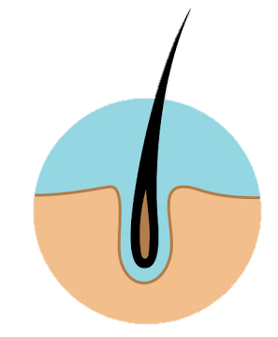
How many hairs do you lose each day?
I don’t! Only old people lose hair!
50 – 100 hairs
per day
1 hair per day

Slide 11
How many hairs do you lose each day?
I don’t! Only old people lose hair!
50 – 100 hairs
per day
1 hair per day

Slide 12
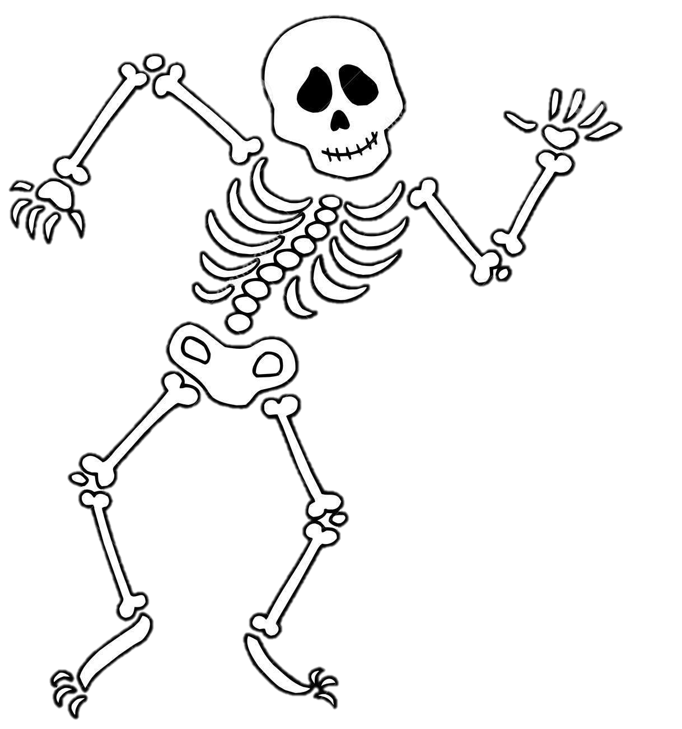
How many bones are in your body?
around 200
1 000 073
15
Notes:
270 when you are born, adults have 206 because some bones fuse togehter

Slide 13
How many bones are in your body?
around 200
(it changes when you grow up)
1 000 073
15
Notes:
270 when you are born, adults have 206 because some bones fuse togehter

Slide 14
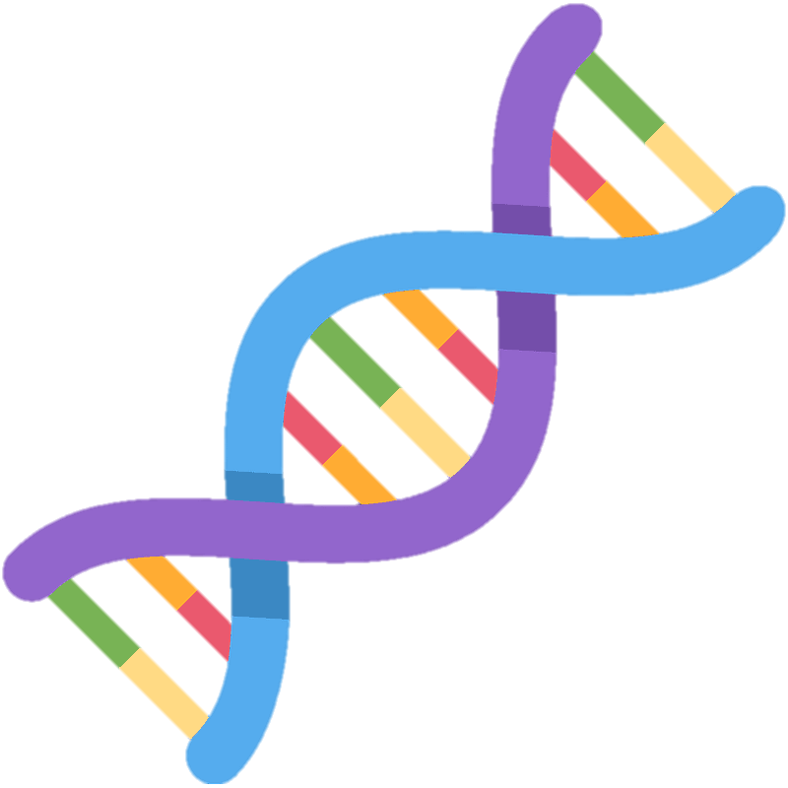
DNA is packed tightly together in all cells of your body and keeps all your biological information.
If you would stretch out all DNA,
how long would it be?
longer than to the sun and back
200 km
(distance from Groningen to Limburg)
50 centimeter
Notes:
270 when you are born, adults have 206 because some bones fuse togehter

Slide 15
DNA is packed tightly together in all cells of your body and keeps all your biological information.
If you would stretch out all DNA,
how long would it be?
longer than to the sun and back
200 km
(distance from Groningen to Limburg)
50 centimeter
Notes:
270 when you are born, adults have 206 because some bones fuse togehter

Slide 16
It is possible to discover some diseases by looking at the DNA of somebody (biological information in your cells).
TRUE
FALSE

Slide 17
It is possible to discover some diseases by looking at the in DNA (biological information in your cells).
TRUE -
FALSE
DNA is a very important source in research

Slide 18
What research is important for you?
(Your opinion – no right or wrong!)
to find new medicines for diseases and treat sick people
to find more forms and flavors for hagelslag
to find out how to make cars faster

Slide 19
What research is important for you?
(Your opinion – no right or wrong!)
to find new medicines for diseases and treat sick people
to find more forms and flavors for hagelslag
to find out how to make cars faster
COOL
VITAL!!!
Lekker
Research into new treatments is very important to help sick people get healthy again! Biobanks help with that research!

Slide 20
How would you feel if your blood would be used for research into new medicines? (No right or wrong ☺)
Good! I would like to help research with that!
No, I wouldn’t like that!
Not sure…
Notes:
Needs to be emphasized here that every opinion is valid but that it is simply a good start to think about it. Refer to more information material on biobanken.nl for example.

Slide 21
Well done! That was fun!
If you want to know more about biobanks and research check out biobanken.nl

Slide 22
Backup organ clipart
Notes:
References of images:
http://clipart-library.com/clipart/one-hair-cliparts_9.htm
https://clipartlook.com/img-17948.html
https://creazilla.com/nodes/54761-dna-emoji-clipart

