Slide 1


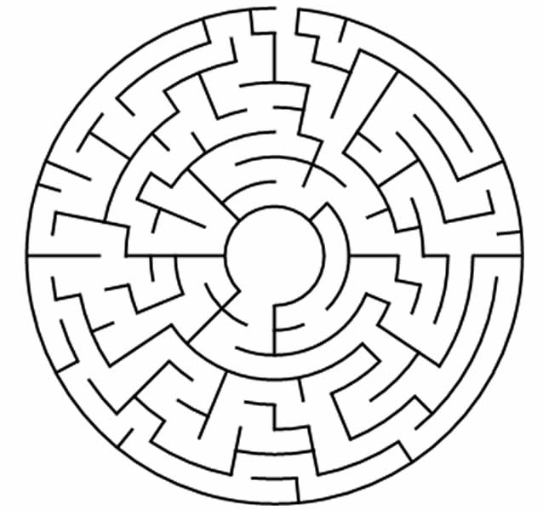


Biobanks help people
FIND THE WAY TO THE NEW MEDICINE
Notes:
https://www.pinterest.com/pin/567523990543705205/
https://playinglearning.com/coloring-sheet.php?i=flu-season-d-is-for-doctor-coloring-page-03
https://printablefreecoloring.com/image/educational/drawing-labyrinths-1.webp

Slide 2
Biobanks help people
FIND THE WAY TO THE NEW MEDICINE
Notes:
https://www.pinterest.com/pin/567523990543705205/
https://playinglearning.com/coloring-sheet.php?i=flu-season-d-is-for-doctor-coloring-page-03

Slide 3
Biobanks help people
FIND THE WAY TO THE NEW MEDICINE
Notes:
https://www.pinterest.com/pin/567523990543705205/
https://playinglearning.com/coloring-sheet.php?i=flu-season-d-is-for-doctor-coloring-page-03

Slide 4
Biobanks help people
FIND THE WAY TO THE NEW MEDICINE
Notes:
https://www.pinterest.com/pin/567523990543705205/
https://playinglearning.com/coloring-sheet.php?i=flu-season-d-is-for-doctor-coloring-page-03

